Slide 1
MAR 530: Ecosystem Based Fisheries Management
Lecture 12
Evaluating tradeoffs
www.mycourses.umassd.edu
24 April 2015

Slide 2
Last Time…
Basis for Governance
Governance Institutions

Slide 3
Today’s Outline
Evaluating tradeoffs
Management Strategy Evaluation
Discussion on:
Sainsbury & Sumaila 2003
de la Mare 2005
Worm et al. 2009
Fulton et al. 2014

Slide 4
One Main Theme Throughout Course
CONFRONTING TRADEOFFS

Slide 5
Simplified Schedule
Week | Theme | Topic
1/30 | Context | Introduction, What is EBFM?
2/6 |  | Challenges facing fisheries, what can EBFM offer?
2/13 |  | Guest lecture: case studies of EBFM
2/20 |  | Types of advice, decision theories, goal-setting
2/27 | Operational | Bycatch, habitat, and spatial management
3/6 |  | Ecosystem indicators
3/13 |  | Extended single-species and multispecies models
3/20 |  | SPRING BREAK
3/27 |  | Aggregate and system models
4/3 |  | Ecological risk assessment
4/10 | Institutional | Societal and economic considerations
4/17 |  | Governance and management institutions
4/24 | Holistic | Evaluating tradeoffs
5/1 |  | Moving towards ecosystem based management
5/8 |  | Final exam: Project Presentations

Slide 6

Dealing with Tradeoffs
If one thing increases, some other thing must decrease.
The idea of a tradeoff implies a decision to be made with full comprehension of both the upside and downside of a particular choice.
In cold climates, mittens serve well to keep the hands warm, but they do not allow the hands to function as well as do gloves.

Slide 7
Dealing with Tradeoffs
Some tradeoffs may be easier than others.
Gain on one, lose on the other.
Don’t have to give up much to gain.
Objective 2
Strong tradeoff, not able to gain on one without giving up a lot on the other.
Objective 1

Slide 8
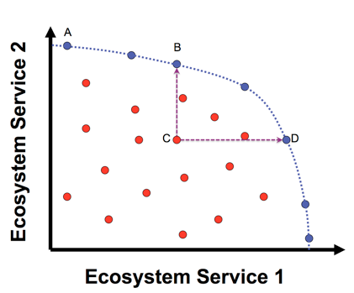
Evaluating Trade-offs
View performance of management strategies against multiple objectives or system traits.
A, B, and D are management options that are optimal solutions for one objective given a value for the other.
Management options in red are sub-optimal for both objectives.

Slide 9
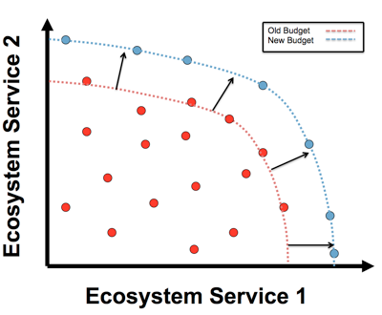
Evaluating Trade-offs
New solutions may change the shape or position of the trade-off frontier.

Slide 10
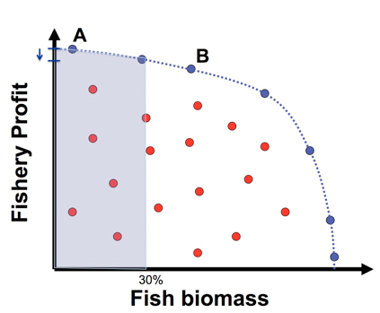
Evaluating Trade-offs
Operational objectives may indicate nonviable options (e.g. minimum stock size thresholds).
Can quantify effects of alternatives.
Here very little loss in profit from A to B is associated with large gain in biomass.

Slide 11
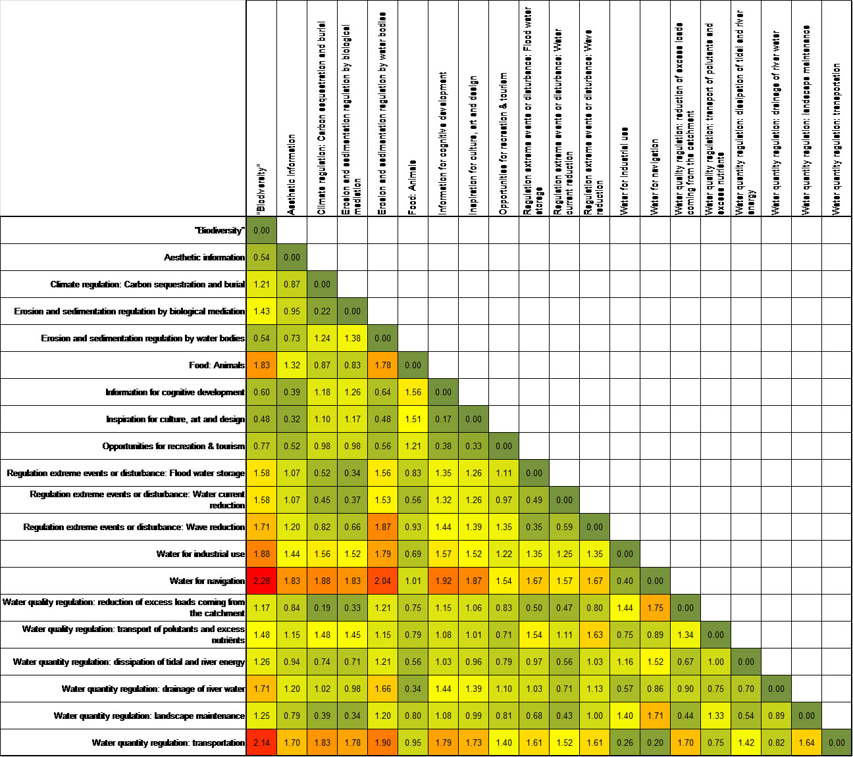
Scoring differences to identify tradeoffs (European Union Tide Toolbox)

Slide 12
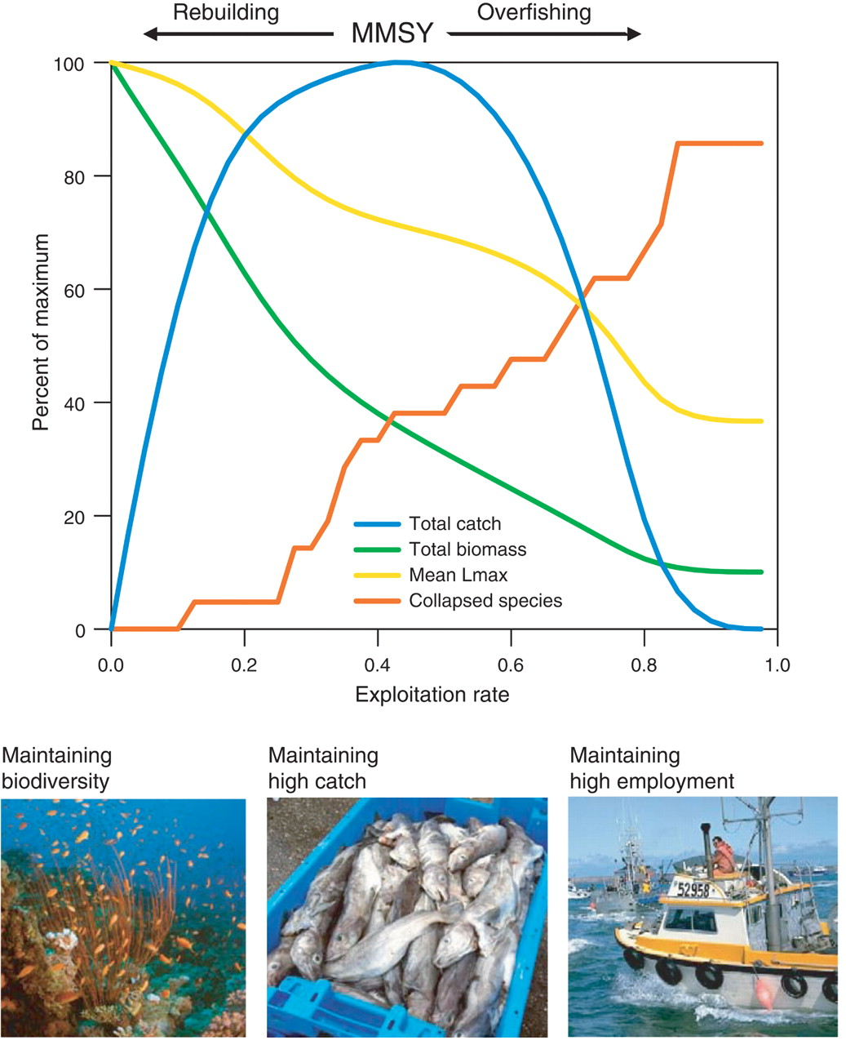
Worm et al. (2009)
Ecosystem models to
quantify tradeoffs between biodiversity, catch, and employment.
Able to gain biodiversity with small loss in fishery yield.

Slide 13
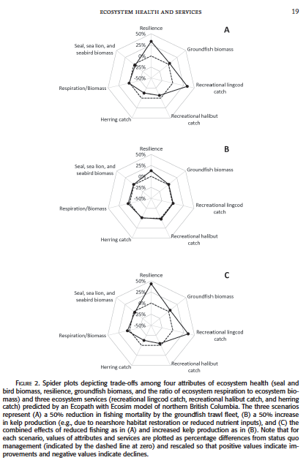
Arkema & Samhouri 2012

Slide 14



Link’s three pillars of management system
1. Goal Setting (Priorities & Allocation of Biomass)
2. Assessing [Ecosystem] Status (Multivariate metrics)
3. Achieving [Ecosystem] Goals (Management Tools)

Slide 15

EBFM Goals
A prioritization within which to evaluate tradeoffs
Non-negotiables
What do we not mess with?
Negotiables
What can we tweak and fiddle with?

Slide 16
Possible priority steps for implementing EBFM
Determine Ecosystem Productivity (S,H)
Protected and Sensitive Species Tax (S,T)
Calculate total Biological Removals Ceiling (S,T)
Allocate total biological removals into sub-ceilings across species or species groups (S,T)
Allocate sub-ceilings to different fleet sectors.
Enforcement & Accountability.
Notes:
S, H, or T are the types of information needed. At the allocation stage, it is all about mgt institutions and not scientific information

Slide 17
Unpacking Laws & Platitudes
From National Law & Policy
e.g. Endangered Species Act
To Conceptual objective
e.g. Biodiversity is good
To Operational objective
e.g. no loss of species richness
A non trivial effort needed here!!!

Slide 18
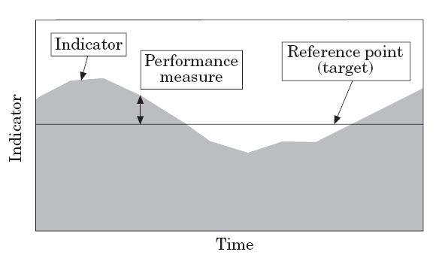
Management Operational Objectives
These identify specific reference points/targets/limits/thresholds for a series of indicators.
There is then a pre-agreed set of “control rules” or triggers if the thresholds are exceeded.
Adapted from Sainsbury et al. 2000

Slide 19
Management Measures and Options
Once our operational objectives are defined, what are the measures/tools/options to enact them?
For EBFM, same as standard management tools, just applied in clever or unique combinations.

Slide 20
Tools to influence the direction of ecosystem change with respect to the fisheries sector
Effort controls
Catch controls
Time or Area management
Gear modifications
Technical controls
Access & property rights
Economic incentives
Social incentives

Slide 21
Management Strategy Evaluation (MSE)
We have established processes for goal setting, prioritization, possible management options, and a method to address tradeoffs
How do we compare alternatives against our performance measures?
MSE is one way to do this.

Slide 22
What is Management Strategy Evaluation?
Simulation framework for:
Examining tradeoff in performance of alternative management strategies across a range of management objectives
Test likely robustness of management strategies.

Slide 23
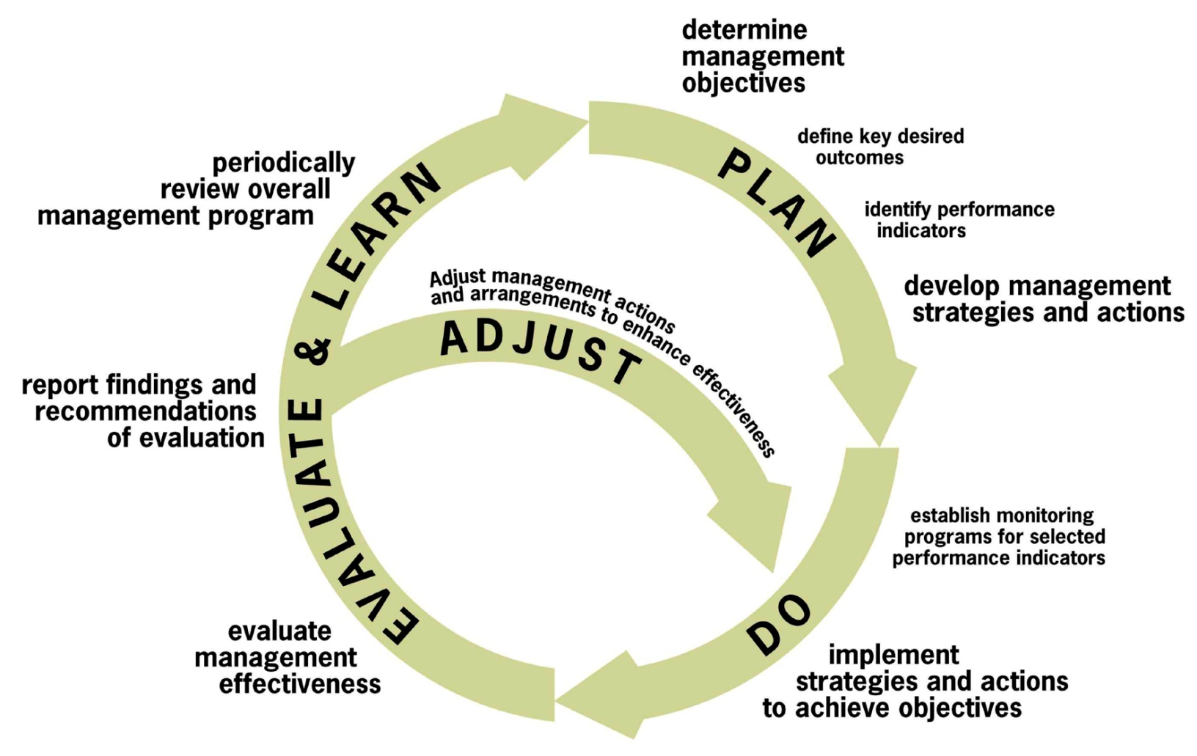
MSE, based off of Adaptive Management. Key part is feedback loop.

Slide 24








Management Strategy Evaluation
By simulating the system, we can evaluate the performance of our management strategies against the known ‘truth’.
We can’t do this in the real world because we don’t actually know what the truth is.
Options that don’t work in the ordered confines of a computer will probably not likely do well in the real world.
Performance measures
Notes:
Comparing indicator-based control rules to single-species approach

Slide 25
Using MSE to flesh out viable management operational objectives
To examine tradeoffs in performance of alternative management strategies across a range of management objectives.
Not to find “optimal” solution.
To help decision makers, not prescribe outcomes.
Can incorporate wide range of objectives (including ecological and economic).

Slide 26
Management Strategy Evaluation
Tool for communication.
Provides a better chance of achieving management objectives (pre-testing to identify robust strategies).
Provides greater certainty for all stakeholders (agreed rules for decision making).
Designed to achieve an agreed balance between competing management objectives.
Designed to be robust to current scientific uncertainty.
Demonstrates to the community that you are managing responsibly (meeting precautionary principle).

Slide 27
Ecosystem indicator control rule performance
MSE tested fishery control rules with ecosystem indicators.
Able to do better against objectives than single-species control rules.
Fay et al. 2014. ICES JMS

Slide 28
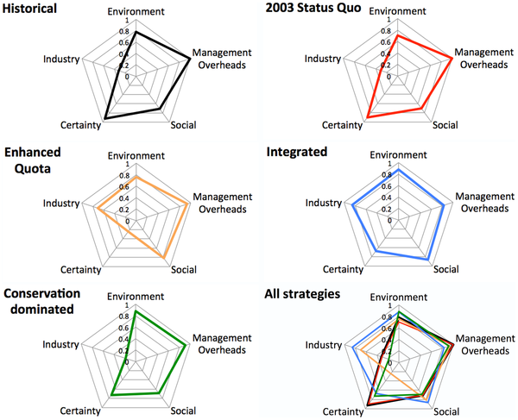
End to end models allow for evaluation of tradeoffs across broader suite of objectives at system level.
Fulton EA, Smith ADM, Smith DC, Johnson P (2014) An Integrated Approach Is Needed for Ecosystem Based Fisheries Management: Insights from Ecosystem-Level Management Strategy Evaluation. PLoS ONE 9(1): e84242. doi:10.1371/journal.pone.0084242
http://127.0.0.1:8081/plosone/article?id=info:doi/10.1371/journal.pone.0084242

Slide 29
A brief return to Risk Analysis
Methods to evaluate the “risk” of not achieving a desired state, or of achieving an undesired state.
Probability framework based on relative weightings/rankings for a set of variables of interest.
Often used as an approach parallel to MSE.
Helps to set operational objectives.

Slide 30
Evaluating management performance

Slide 31
Evaluating management pserformance
Finally, how well do our management tools/measures/strategies perform?
What is the status of an indicator(s) relative to the reference point(s) after management action?
If management measures don’t behave or a tool is not performing well, need framework for:
1) evaluating that this is so,
2) change strategies to something more appropriate
The key is “closing the loop” in the management cycle to get this feedback.
Doing so is fairly rare unless institutions are structured to do so.

Slide 32
Doing EBFM
Questions?

Slide 33
What’s Next?
Beyond fisheries, moving toward Ecosystem-Based Management
Discussion on:
Leslie & McLeod 2007
Murawski 2007
Berkes 2011
Bunnefeld et al. 2011

